Slide 1
Data Science Workflow: From Getting Data to Deployment
Raden Muhammad Hadi

Slide 2
Outline
Data Science Process
Data Science Workflow
Getting
Pre-processing
Exploring
Modeling
Evaluating + Interpreting
Deploying

Slide 3


Slide 4
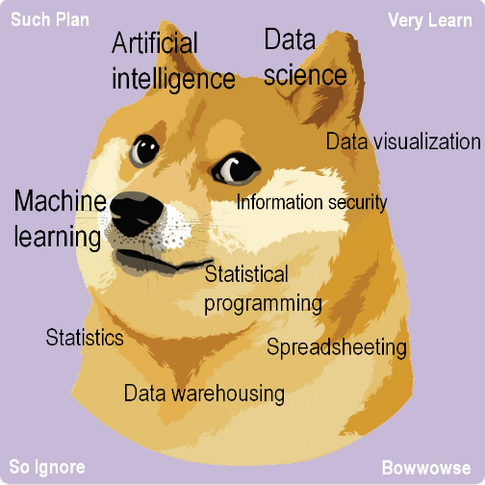

Slide 5
Ever think to do data science but don’t know where to start?

Slide 6
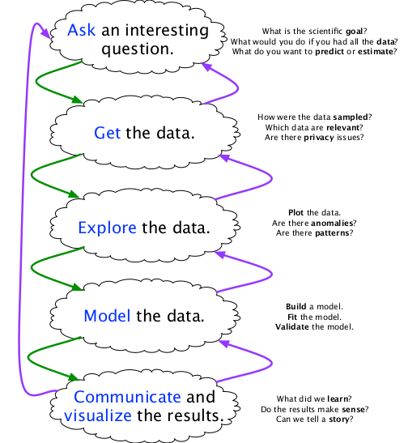
Data Science Process

Slide 7
Data Science Pipeline

Slide 8
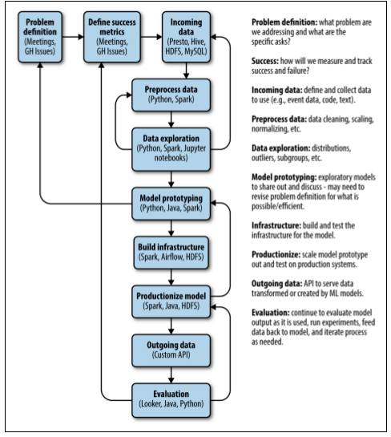
GitHub’s Data Science Workflow

Slide 9
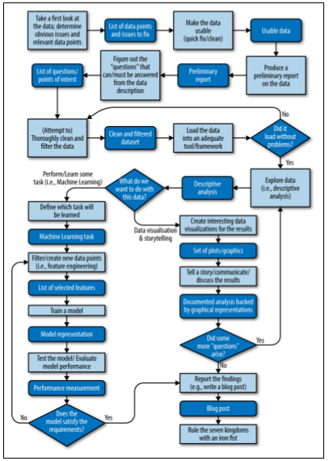
Binary Edge’s Data Science Workflow

Slide 10
Getting Data

Slide 11
Getting Data: Data Type
Structured Data
CSV (Comma Separated Value)
XLS & XLSX (Excel File)
SQL Data
Unstructured Data
JSON
Text
Sound
Video
Image

Slide 12
 | Structured Data | Unstructured Data
Characteristics | Pre-defined Data Models | No pre-defined data model
Resides in | Relational Data Base | Non-Relational Database
Typical Applications | Hotel reservation Inventory control Costumer Relationship Management etc | Word processing Email clients Speech-to-text Translation
Examples | Time series data Phone-book Official statistics Public financing Credit card transactions | Text Files Email messages Audio files Video files Images files

Slide 13
Pre-Processing Data

Slide 14
Data Pre-Processing: Definition
Data Pre-Processing is a data mining techniques that involves transforming raw data into an understandable format.

Slide 15
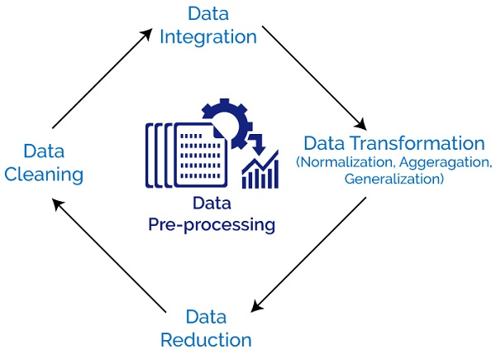
Data Pre-processing: The Big Picture

Slide 16
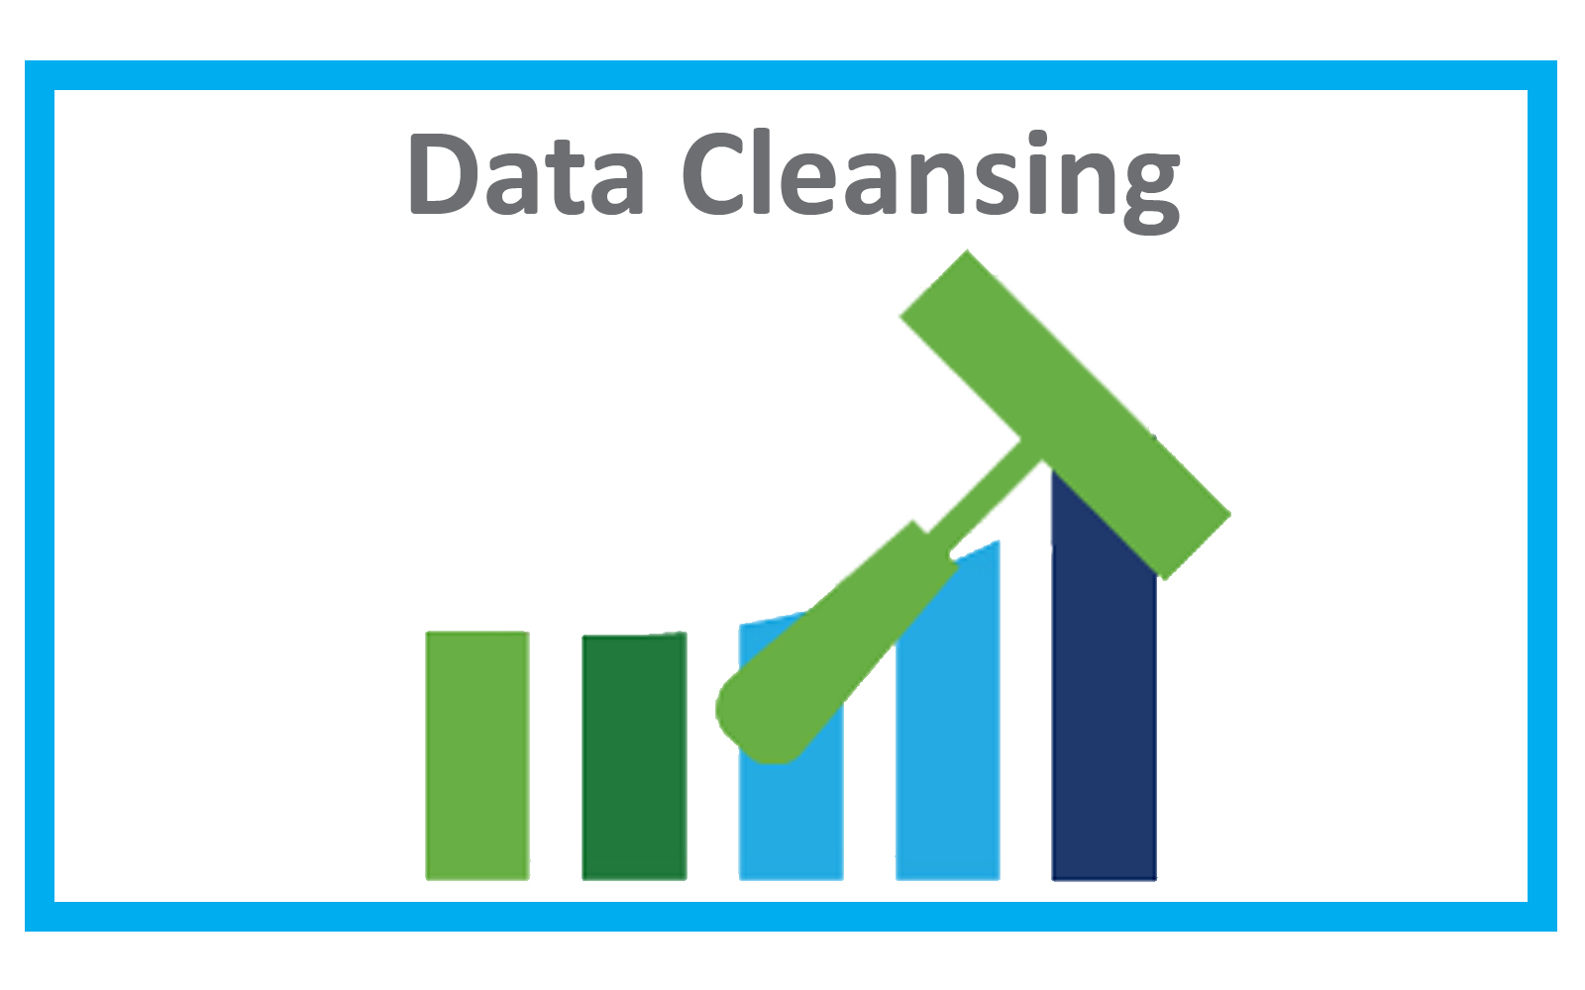
Data Pre-Processing: Data Cleaning
Data is cleansed through processes such as filling in missing values, smoothing the noisy data, or resolving the inconsistencies in the data.

Slide 17
Filling in Missing Value
No | staff_id | attendance_by_month | sales_revenue
1 | 32432-sdf | 25 | 2500000
2 | 65764-dnm | 25 | 1500000
3 | 34055-ldf | 20 | NA
4 | 00455-qdd | NA | 2000000
5 | 02313-dqa | 20 | 3500000
6 | NA | 25 | 1000000

Slide 18
Imputation Using Means
No | staff_id | attendance_by_month | sales_revenue
1 | 32432-sdf | 25 | 2500000
2 | 65764-dnm | 25 | 1500000
3 | 34055-ldf | 20 | NA
4 | 00455-qdd | NA | 2000000
5 | 02313-dqa | 20 | 3500000
6 | NA | 25 | 1000000
Mean of attendance_by_month
=
(25+25+20+20+25)/5
=
23

Slide 19
Imputation Using Means
No | staff_id | attendance_by_month | sales_revenue
1 | 32432-sdf | 25 | 2500000
2 | 65764-dnm | 25 | 1500000
3 | 34055-ldf | 20 | NA
4 | 00455-qdd | 23 | 2000000
5 | 02313-dqa | 20 | 3500000
6 | NA | 25 | 1000000
Mean of attendance_by_month
=
(25+25+20+20+25)/5
=
23

Slide 20
Imputation Using Means
No | staff_id | attendance_by_month | sales_revenue
1 | 32432-sdf | 25 | 2500000
2 | 65764-dnm | 25 | 1500000
3 | 34055-ldf | 20 | NA
4 | 00455-qdd | 23 | 2000000
5 | 02313-dqa | 20 | 3500000
6 | NA | 25 | 1000000
Mean of sales_revenue
=
(2500000 + 1500000 + 2000000 + 3500000 + 1000000)/5
=
2100000

Slide 21
Imputation Using Means
No | staff_id | attendance_by_month | sales_revenue
1 | 32432-sdf | 25 | 2500000
2 | 65764-dnm | 25 | 1500000
3 | 34055-ldf | 20 | 2100000
4 | 00455-qdd | 23 | 2000000
5 | 02313-dqa | 20 | 3500000
6 | NA | 25 | 1000000
Mean of sales_revenue
=
(2500000 + 1500000 + 2000000 + 3500000 + 1000000)/5
=
2100000

Slide 22
Imputation Using Median
Median of attendance_by_month
=
20,20,25,25,25
=
25
No | staff_id | attendance_by_month | sales_revenue
1 | 32432-sdf | 25 | 2500000
2 | 65764-dnm | 25 | 1500000
3 | 34055-ldf | 20 | NA
4 | 00455-qdd | NA | 2000000
5 | 02313-dqa | 20 | 3500000
6 | NA | 25 | 1000000

Slide 23
Imputation Using Median
Median of attendance_by_month
=
20,20,25,25,25
=
25
No | staff_id | attendance_by_month | sales_revenue
1 | 32432-sdf | 25 | 2500000
2 | 65764-dnm | 25 | 1500000
3 | 34055-ldf | 20 | NA
4 | 00455-qdd | 25 | 2000000
5 | 02313-dqa | 20 | 3500000
6 | NA | 25 | 1000000

Slide 24
Imputation Using Median
No | staff_id | attendance_by_month | sales_revenue
1 | 32432-sdf | 25 | 2500000
2 | 65764-dnm | 25 | 1500000
3 | 34055-ldf | 20 | NA
4 | 00455-qdd | 25 | 2000000
5 | 02313-dqa | 20 | 3500000
6 | NA | 25 | 1000000
Median of sales_revenue
=
1000000, 1500000, 2000000, 2500000, 3500000
=
2000000

Slide 25
Imputation Using Median
No | staff_id | attendance_by_month | sales_revenue
1 | 32432-sdf | 25 | 2500000
2 | 65764-dnm | 25 | 1500000
3 | 34055-ldf | 20 | 2000000
4 | 00455-qdd | 25 | 2000000
5 | 02313-dqa | 20 | 3500000
6 | NA | 25 | 1000000
Median of sales_revenue
=
1000000, 1500000, 2000000, 2500000, 3500000
=
2000000

Slide 26
Imputation Using Mode
Mode of attendance_by_month
=
20,20,25,25,25
=
25
No | staff_id | attendance_by_month | sales_revenue
1 | 32432-sdf | 25 | 2500000
2 | 65764-dnm | 25 | 1500000
3 | 34055-ldf | 20 | NA
4 | 00455-qdd | NA | 2000000
5 | 02313-dqa | 20 | 3500000
6 | NA | 25 | 1000000

Slide 27
Imputation Using Mode
Mode of sales_revenue
=
?
No | staff_id | attendance_by_month | sales_revenue
1 | 32432-sdf | 25 | 2500000
2 | 65764-dnm | 25 | 1500000
3 | 34055-ldf | 20 | NA
4 | 00455-qdd | 25 | 2000000
5 | 02313-dqa | 20 | 3500000
6 | NA | 25 | 1000000

Slide 28
Advanced Imputation Method
Linear regression
K-Nearest Neighbors
Hot-Deck Imputation
Ensemble Method
etc...

Slide 29
Resolving Inconsistencies
ID | SEX | Birth Date
1 | Male | 1990-10-1
2 | Female | 1993-1-12
3 | Fem | October 12, 1999
4 | F | 2000-15-10
5 | Male | 2001-10-12

Slide 30
Resolving Inconsistencies
ID | SEX | Birth Date
1 | Male | 10-1-1990
2 | Female | 1993-1-12
3 | Female | 12-10-1999
4 | Female | 15-10-2000
5 | Male | 10-12-2001

Slide 31
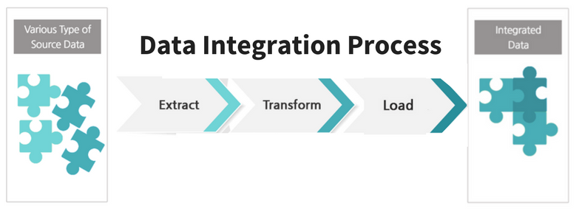
Data Preprocessing: Data Integration
Data with different representations are put together and conflicts within the data are resolved.

Slide 32
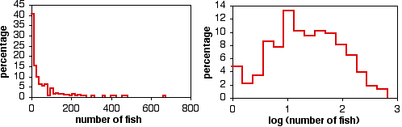
Data Preprocessing: Data Transformation
Data is normalized, aggregated and generalized.

Slide 33
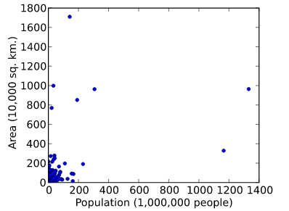

Slide 35
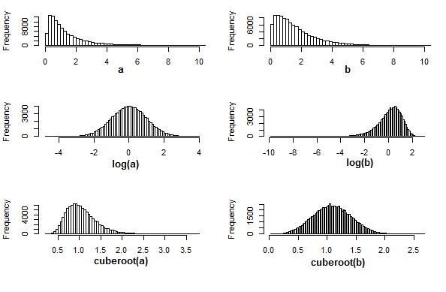

Slide 36
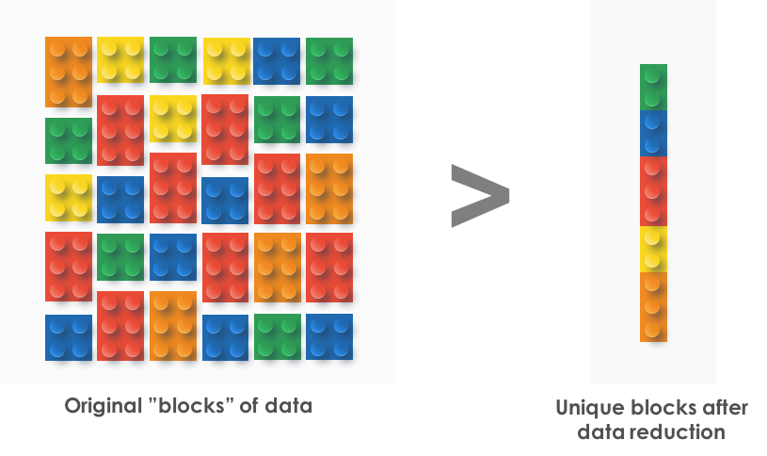
Data Preprocessing: Data Reduction
This step aims to present a reduced representation of the data.

Slide 37
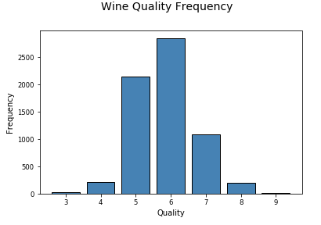
1 Dimensional Data

Slide 38
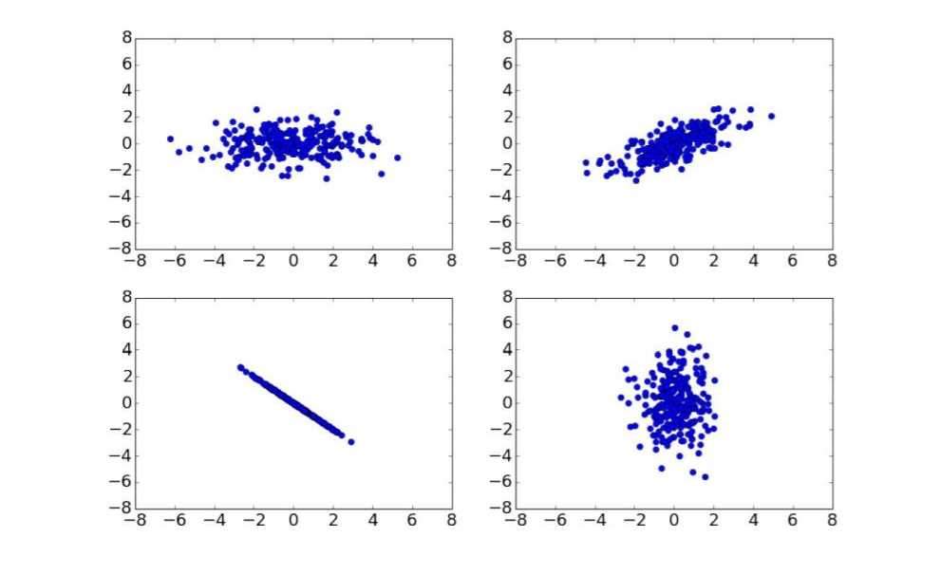
2 Dimensional Data

Slide 39
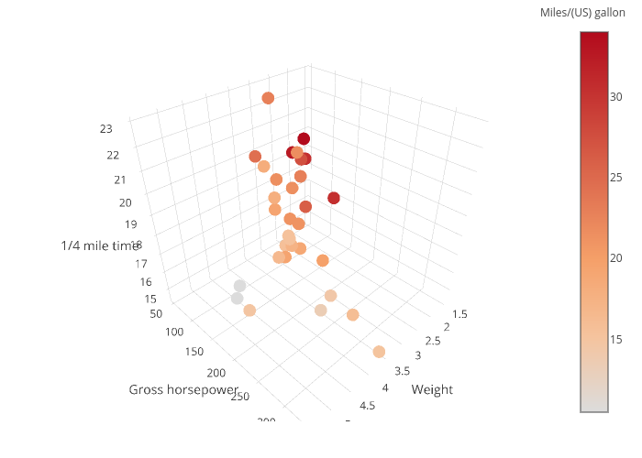
3 Dimensional Data

Slide 40
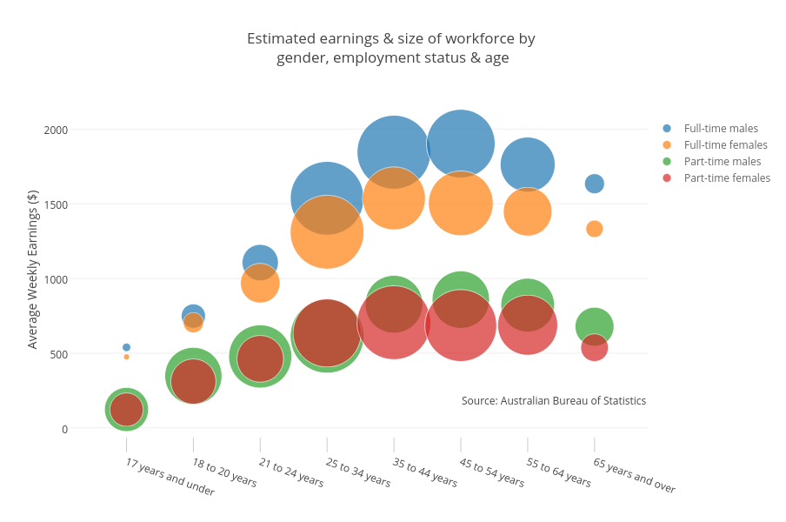
3 Dimensional Data

Slide 41
4 Dimensional Data
?

Slide 42
4 Dimensional Data

Slide 43
5 Dimensional Data ?
6 Dimensional Data ?
7 Dimensional Data ?

Slide 44
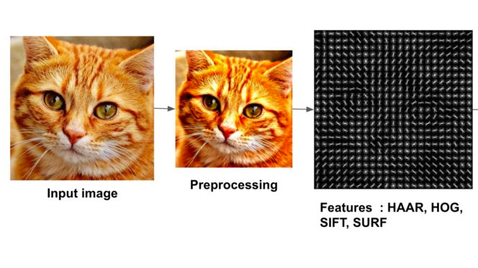
Curse of Dimensionality
Dataset sometimes high dimensional
Fraud Data
Images: 28 x 28 pixels
Words: 1000000 words = 1000000 features!
Example:
Cat Images

Slide 45
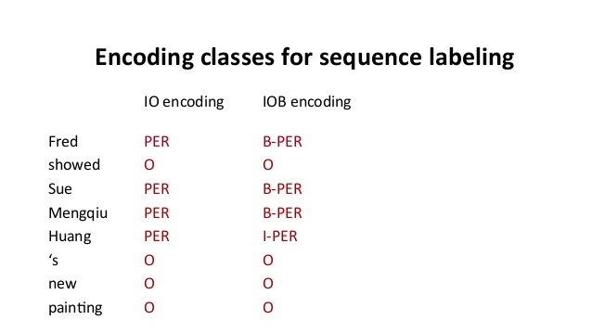
Curse of Dimensionality
High computational cost
Some features are redundant
Human labeling is expensive

Slide 46
Cure the Curse
Use domain knowledge
Feature selection
Feature importance
PCA

Slide 47
Cure the Curse
Feature extraction
Construct new dimension
Can be automated using algorithm:
Ensemble, Feature Synthesis, etc

Slide 48
Exploring Data

Slide 49
Exploring Data: Definition
Exploratory Data Analysis:
Is an approach/philosophy for data analysis that employs a variety of techniques (mostly graphical) to
maximize insight into a data set;
uncover underlying structure;
extract important variables;
detect outliers and anomalies;
test underlying assumptions;
develop parsimonious models; and
determine optimal factor settings.
From:https://www.itl.nist.gov/div898/handbook/eda/section1/eda11.htm

Slide 50
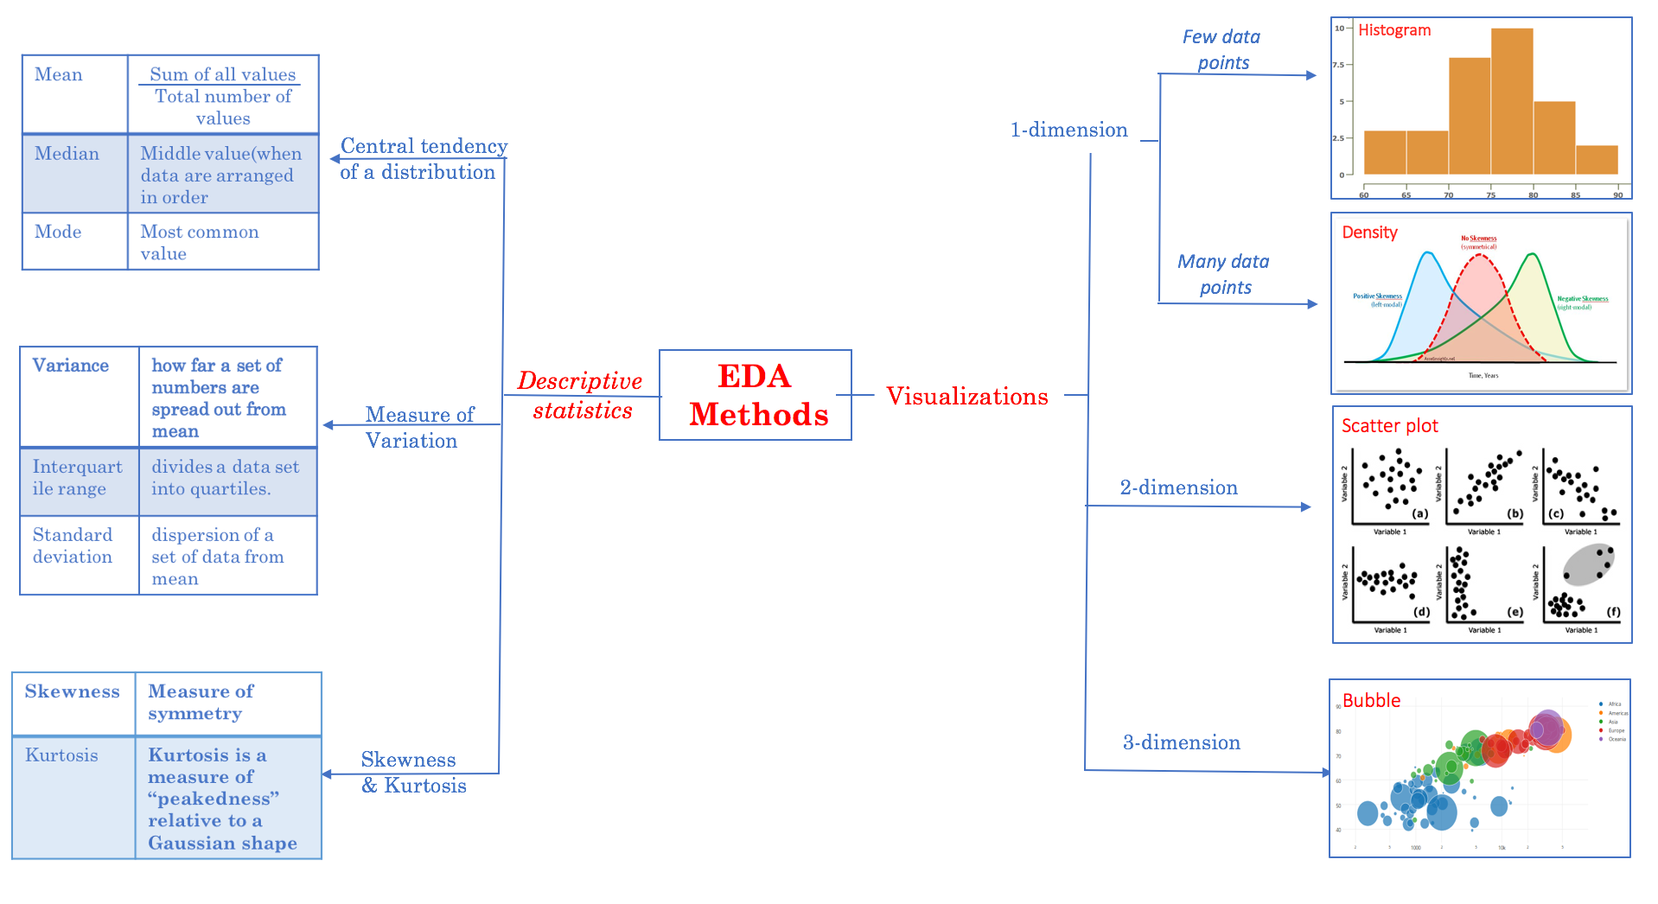
From: http://www.jeannjoroge.com/significance-of-exploratory-data-anaysis/

Slide 51
Modeling

Slide 52
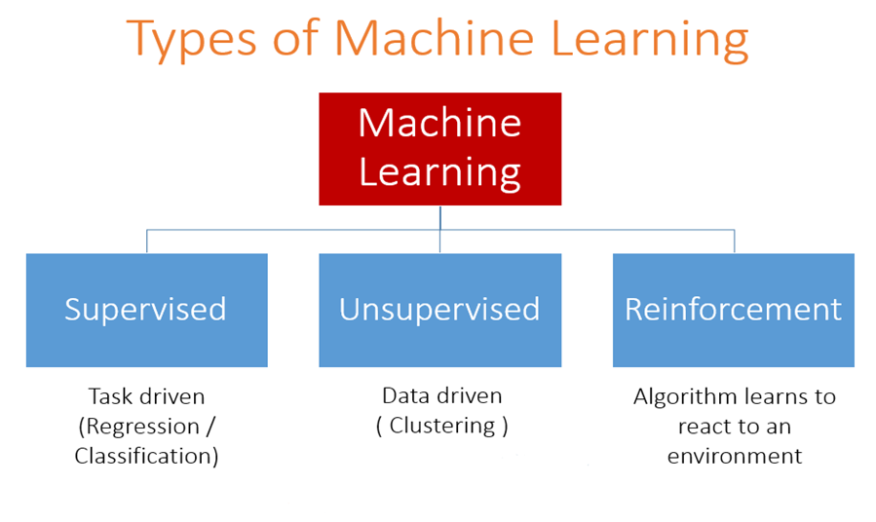
Modeling: Types

Slide 53
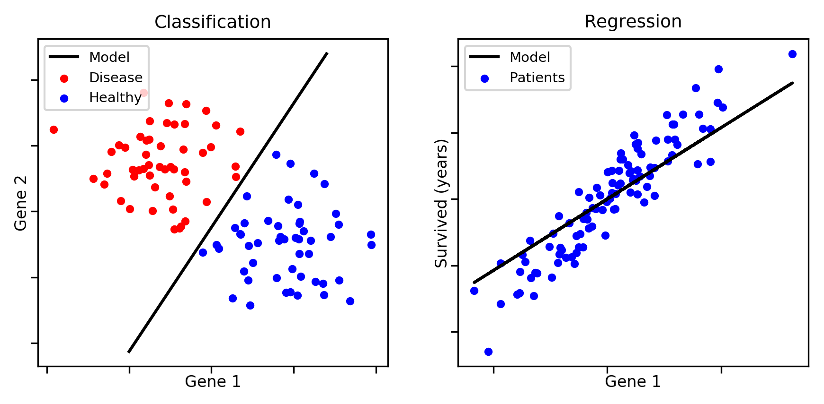
Supervised Machine Learning

Slide 54
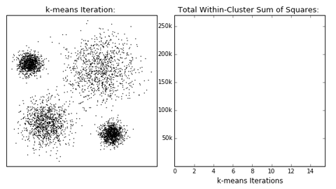
Unsupervised Learning

Slide 55
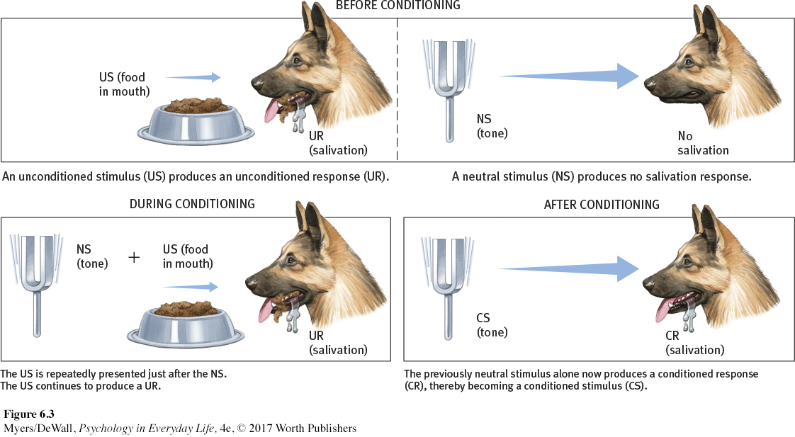
Reinforcement Learning

Slide 57
How to choose one type from another ?

Slide 58
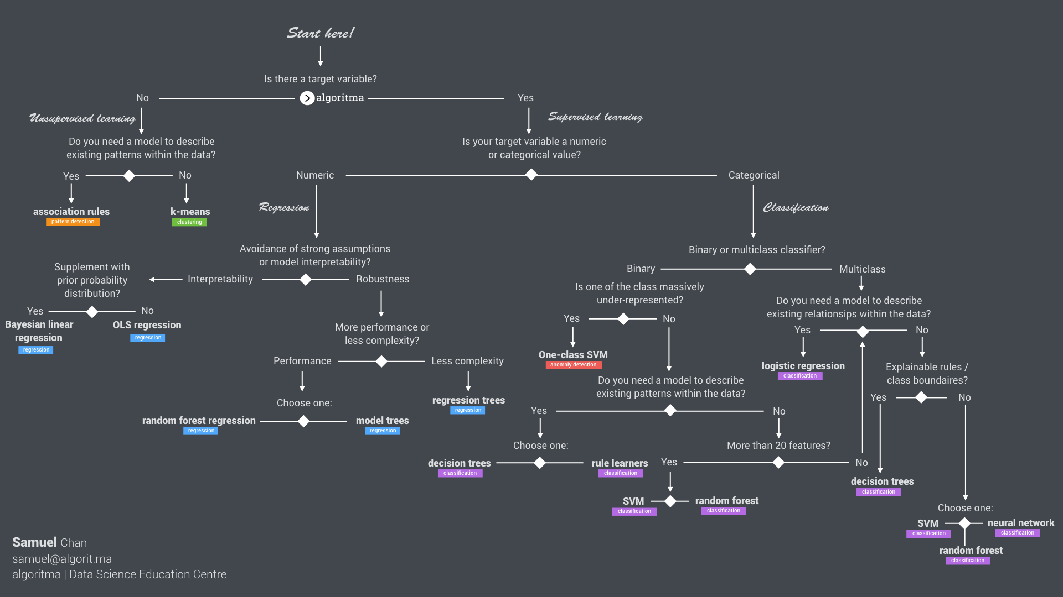
Machine Learning Cheat Sheet

Slide 59
Evaluating and Interpreting

Slide 60
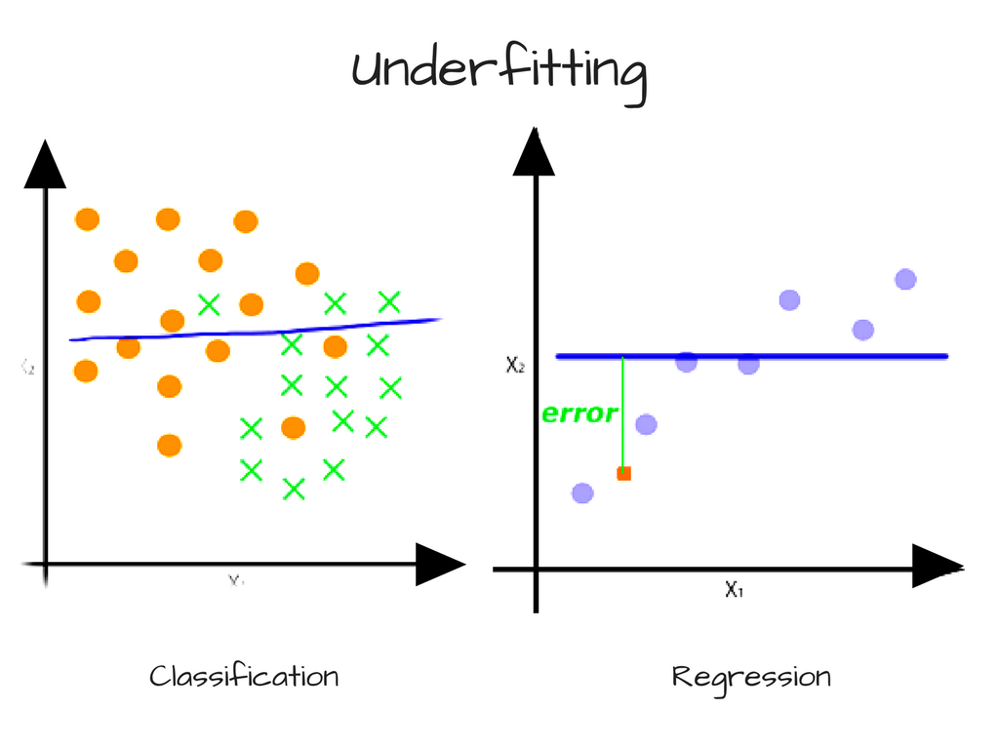
The Why

Slide 61
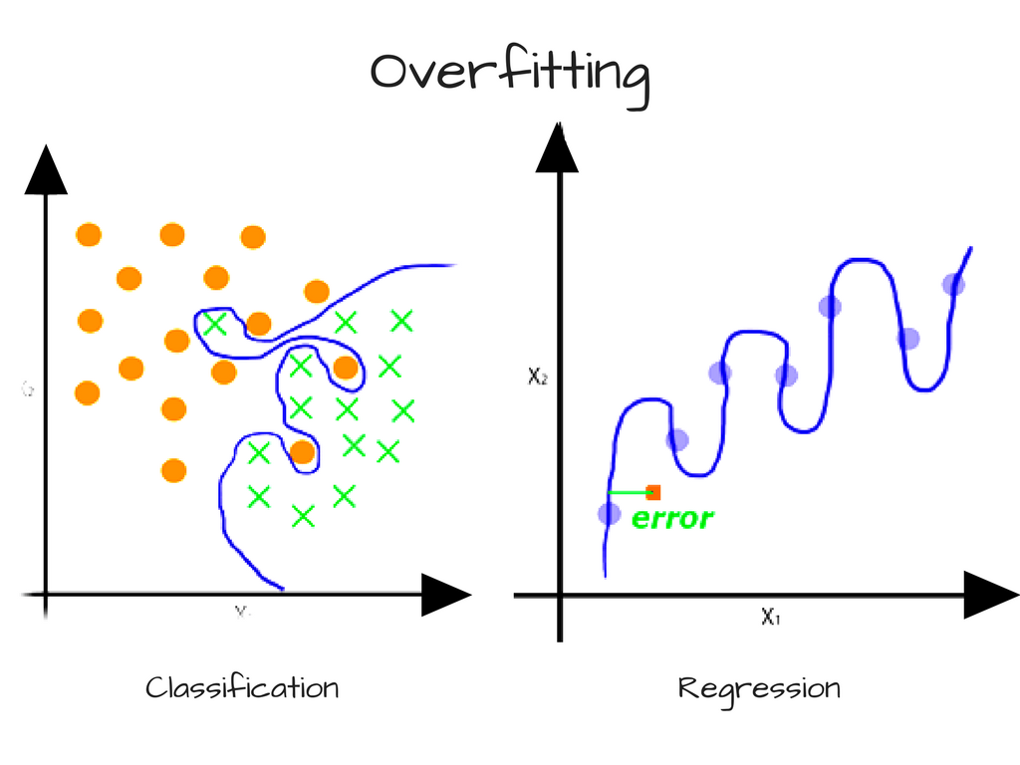
The Why

Slide 62
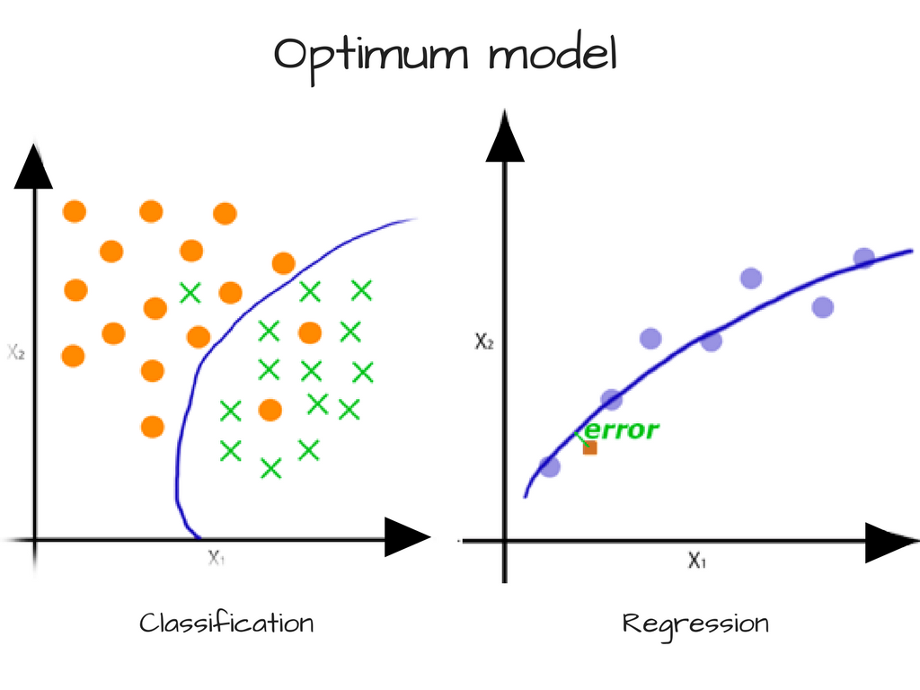
The Why

Slide 63
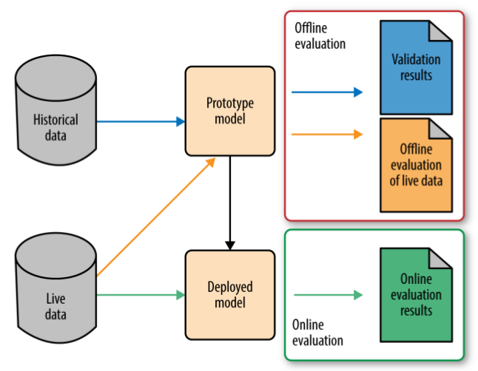
The How: Two Kinds of Evaluation
Offline Evaluation
Measures offline metrics of prototyped model on historical data.
Online Evaluation
Measures live metrics of deployed model on live data.

Slide 65
Evaluating Your Model
Classification Metrics
Accuracy
Confusion Matrix
Log-Loss
ROC/AUC
Regression Metrics
Root-Mean-Square Error
Mean Absolute Percentage Error
Clustering Metrics
Dunn Index
Silhouette Coefficient
Hopkins Statistics

Slide 66

Classification Metrics: Accuracy
Accuracy is the fraction of predictions our model got right

Slide 67
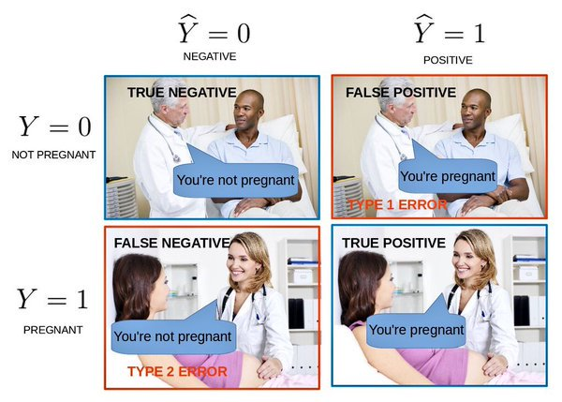
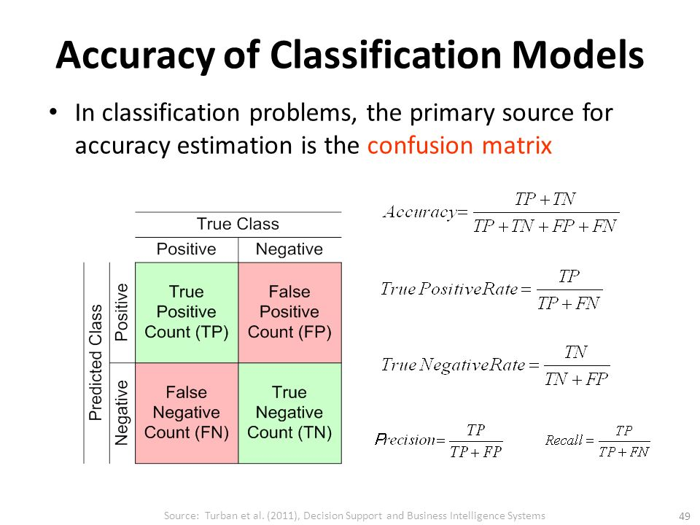
Higher is better (but not always!)

Slide 68
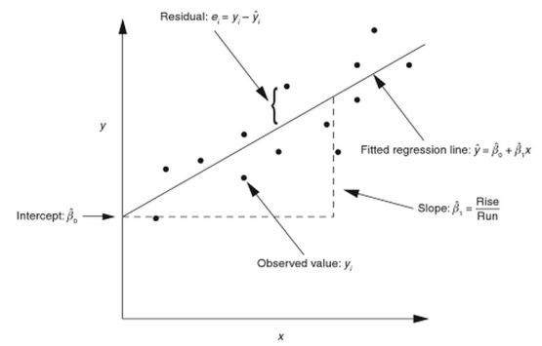
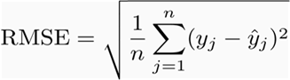
Regression Metrics: RMSE
Smaller is better

Slide 69
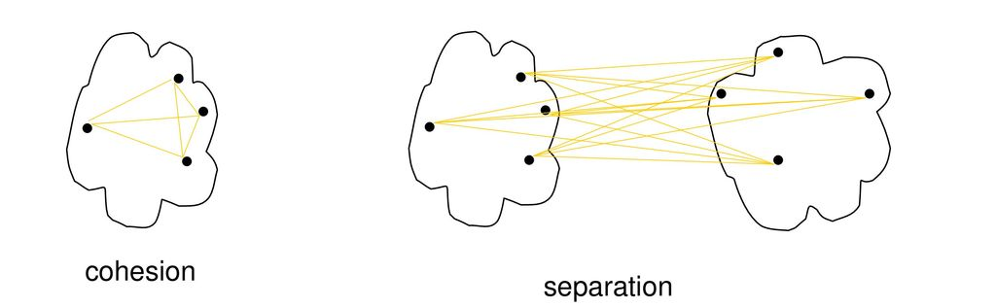
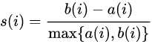
Clustering Metrics: Silhouette Coefficient
Average distance between cluster
Average distance inside cluster
Bigger than 0: Well clustered
Equal with 0: Only 1 cluster
Smaller than 0: Poorly clustered

Slide 70
Interpreting Your Model
If a machine learning model performs well, why not just trust the model and ignore why it made a certain decision?
“The problem is that a single metric, such as classification accuracy, is an incomplete description of most real-world tasks.”
(Doshi-Velez and Kim 2017 in “Towards A Rigorous Science of Interpretable Machine Learning”)

Slide 71
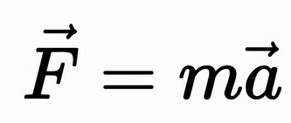
Newton’s Second Law

Slide 72
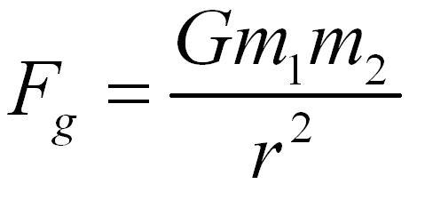
Gravitational Force

Slide 73
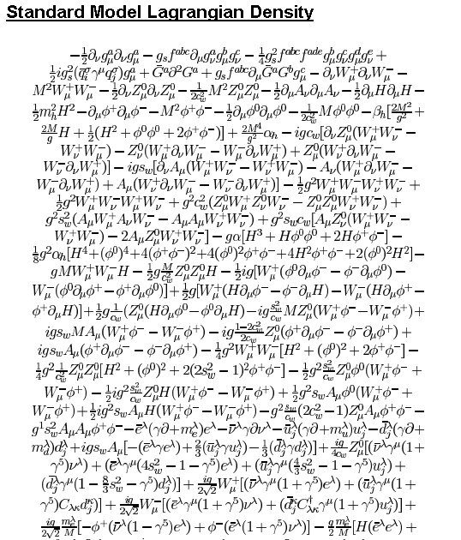
Standard Model
Explanation:
https://bit.ly/2QrGawL

Slide 74
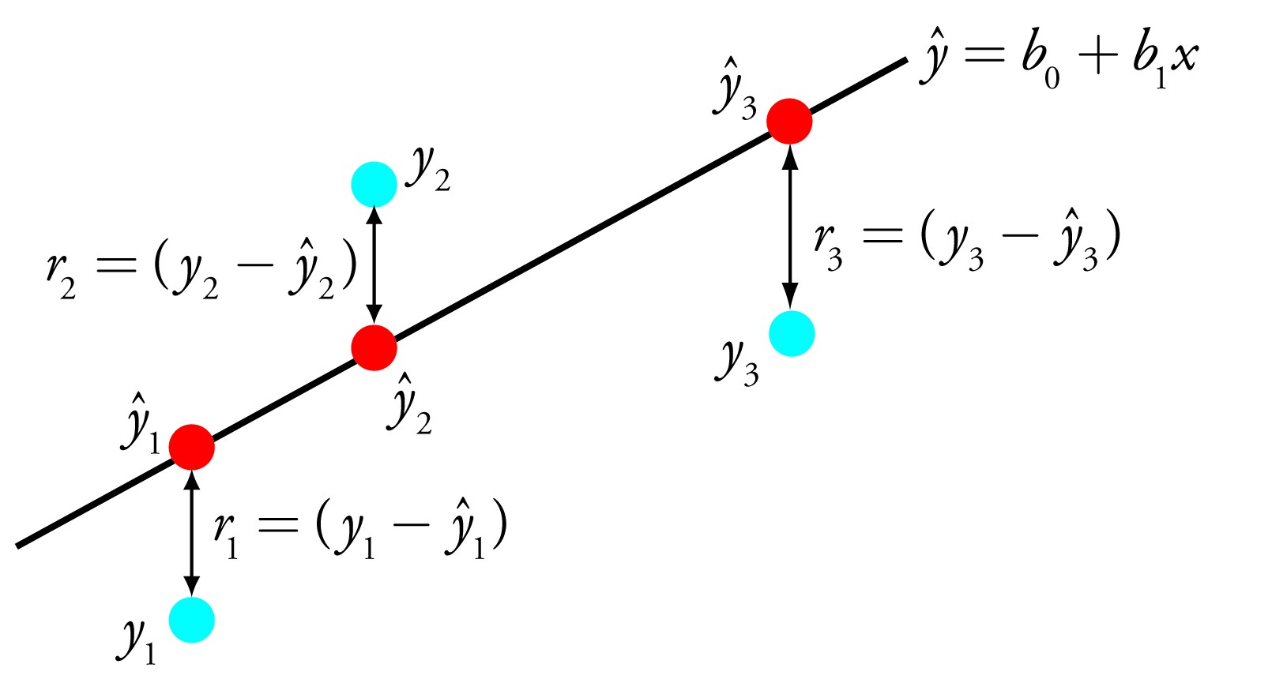
Linear Regression

Slide 75
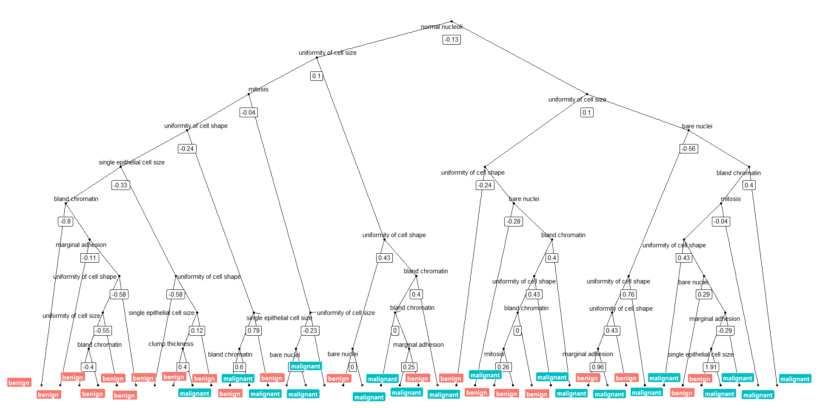
Random Forest

Slide 76
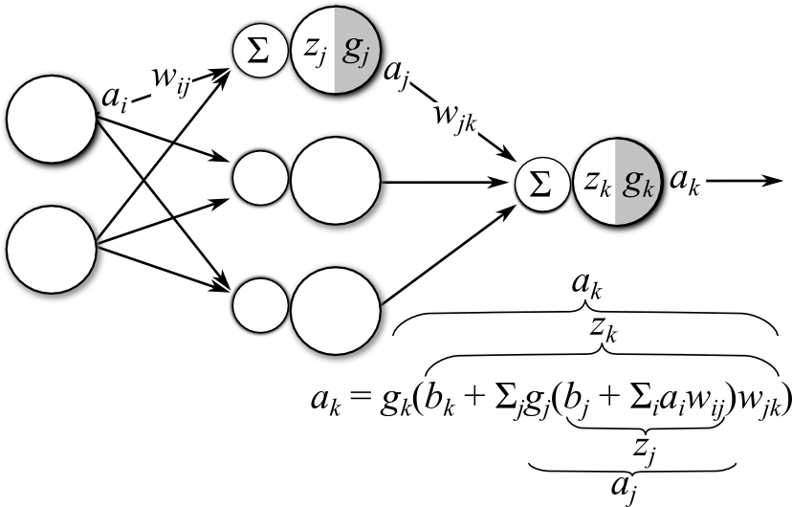
Neural Network

Slide 77
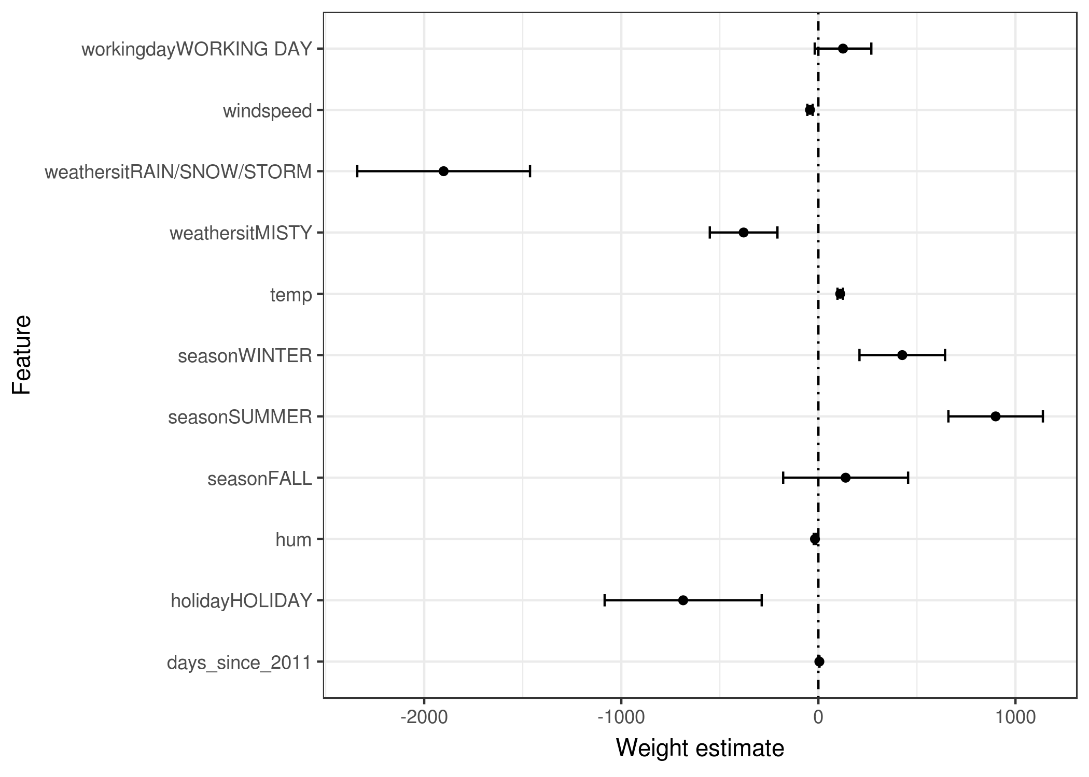
Weight Plot

Slide 78
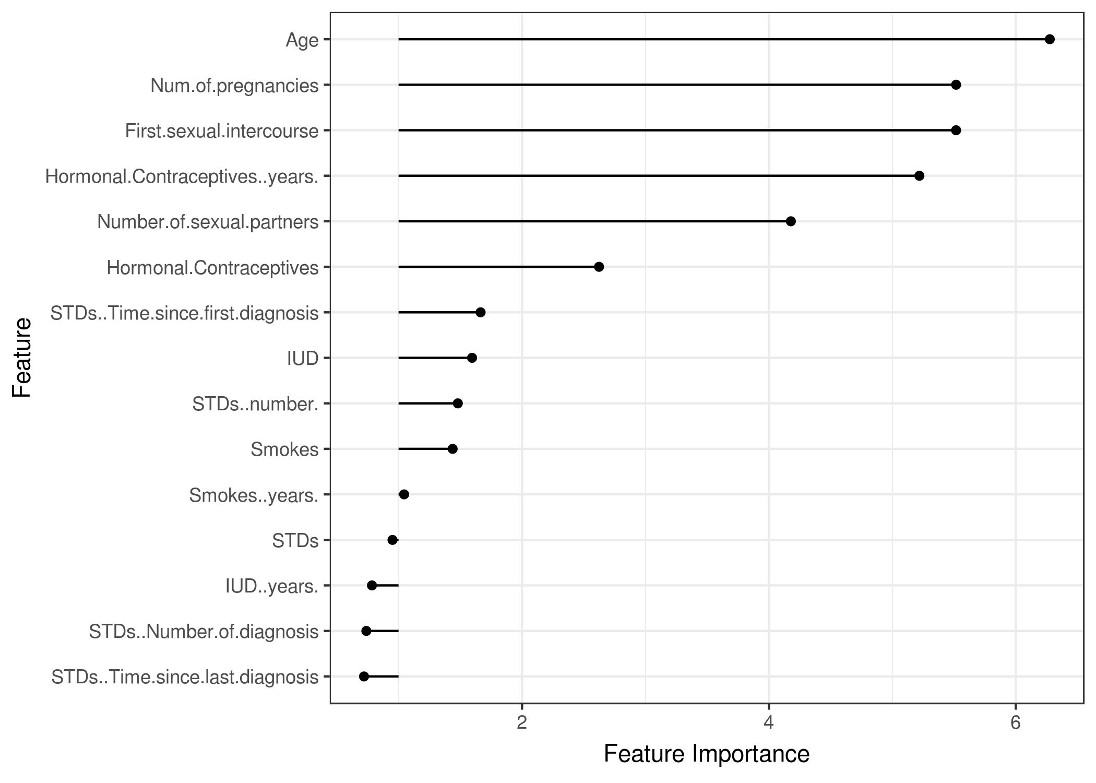
Feature Importance

Slide 79
Deploying

Slide 80
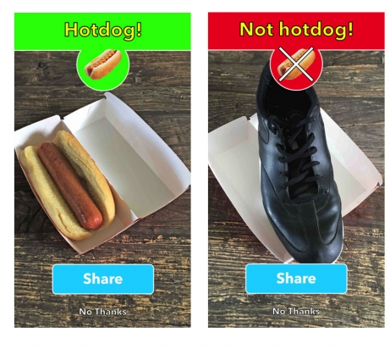
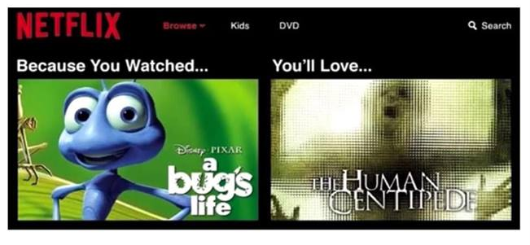
Implement Your Model as Data Products
Mobile Application
Web Application

Slide 81
R vs Python
R
Shiny
Plumber
Shiny-Proxy
Support Library
ggplot2
R2d3
Plotly
Leaflet
Python
Django
Flask
Dash
Support Library
Plotly
Bokeh
Leaflet

Slide 82
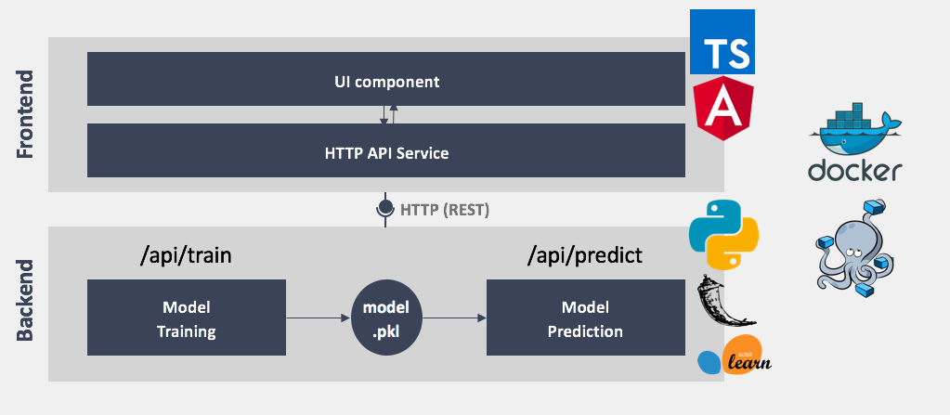
Example: Web Application

Slide 83
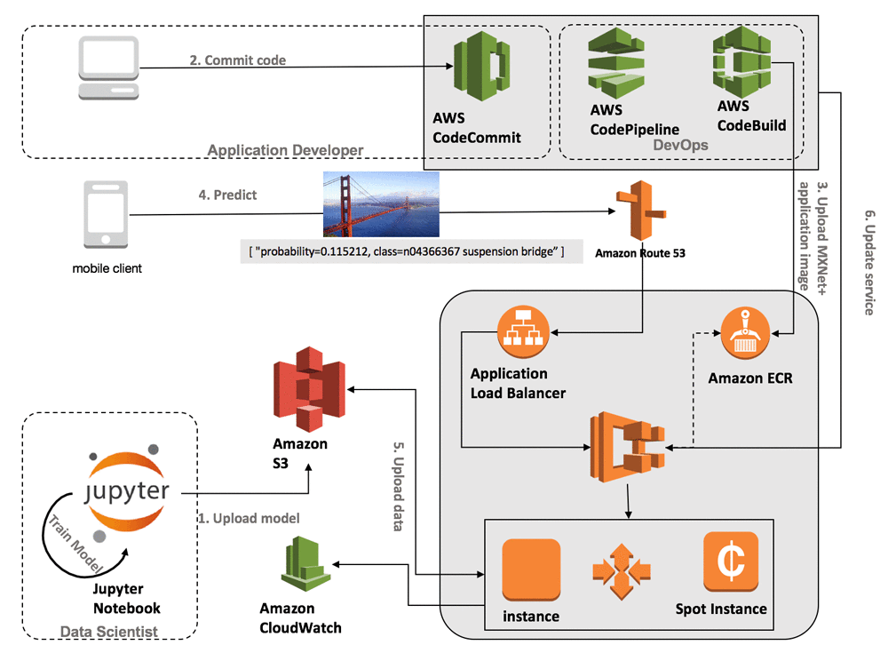
Example: Big Data ML

Slide 84
Question

